Slide 1

Relief
By:
Anuja Patil(002797645)
Shivani Sahu(002737279)
Shreya Baliga(002795178)

Slide 2
Problem Statement
As many people today are facing health issue which are often ignored to later become a serious disease.
People who have suffered from brain tumours are often seen to be disregarding their early symptoms such as change in oxygen level,frequent headaches and difficulty with balance.
Huge expenses for medical bills and other miscellaneous expenses have also made brain tumor patients difficult to hire a help.

Slide 3
Proposed Solution
Relief is a user friendly application which connects a patient, volunteer,doctors and NGOs.
Volunteers are the people from the community who are going to help the patients with all the physical activities.
They monitor the patients using a device and send alert messages to them.
Doctors can then check the patient’s data through this application and write a prescription.
Donors can use the application to make donations.

Slide 4
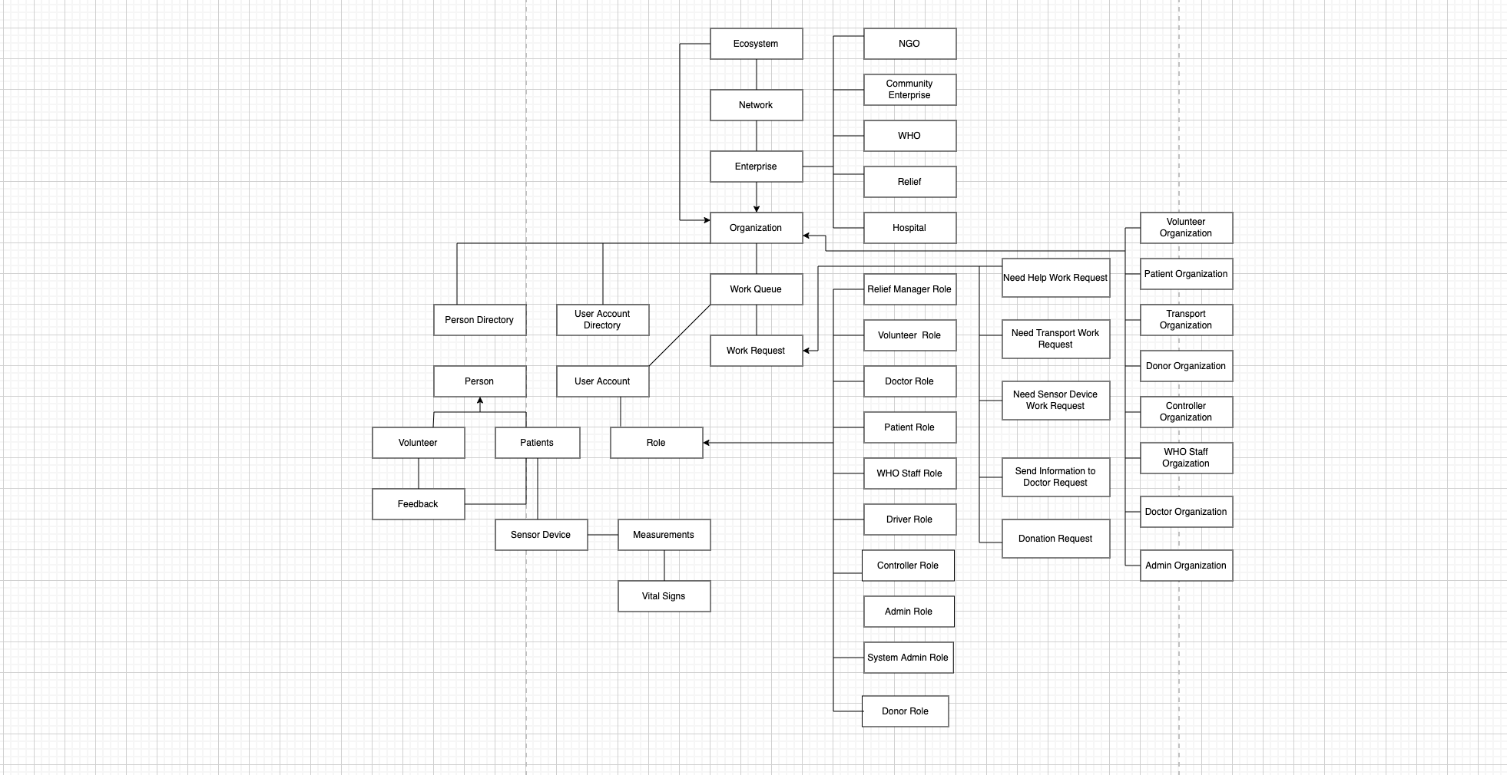

Slide 5
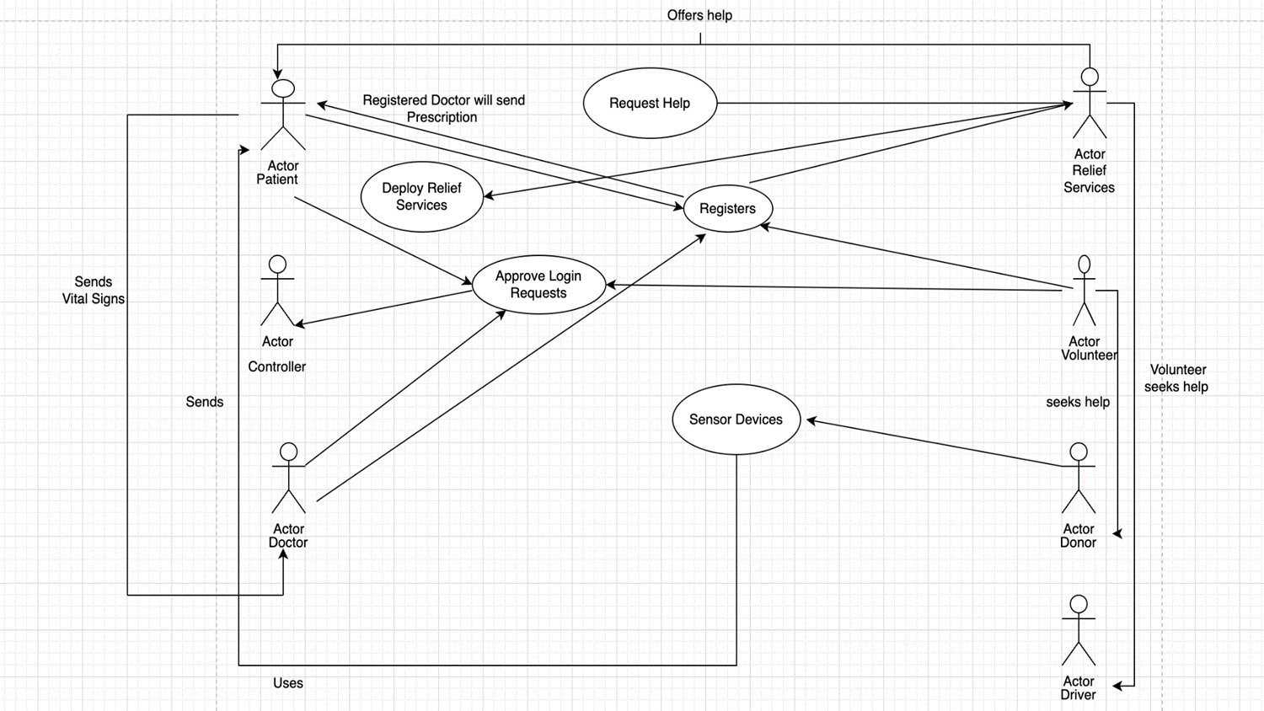

Slide 6
Features
Login and Register Functionality
Email Notification to users.
Search functionality for networks.
CRUD Operations
Visualization/Analysis
User friendly and easy application.
Authentication
SMS for notification

Slide 7
Key Roles
Patient Role: Patient can ask volunteer for help, request the donors for wearable devices and send requests to doctor for medications.
Volunteer Role: They are responsible to fulfill patient’s requests. If required, they can also seek help from Transport Organization to help the patients.
Controller Role: They are solely responsible to approve the volunteer, patient and doctor requests.
Doctor Role: Patients can track the vital signs using the sensor devices and then send them to the doctor via “RELIEF”. The doctors can then reply with medications.
Relief Manager: Manager is responsible to make sure that the system is working efficiently.
Donor Role: They can make donations by processing the patient’s requests asking for wearable devices or by donating some amount to “RELIEF” enterprise account.

Slide 8
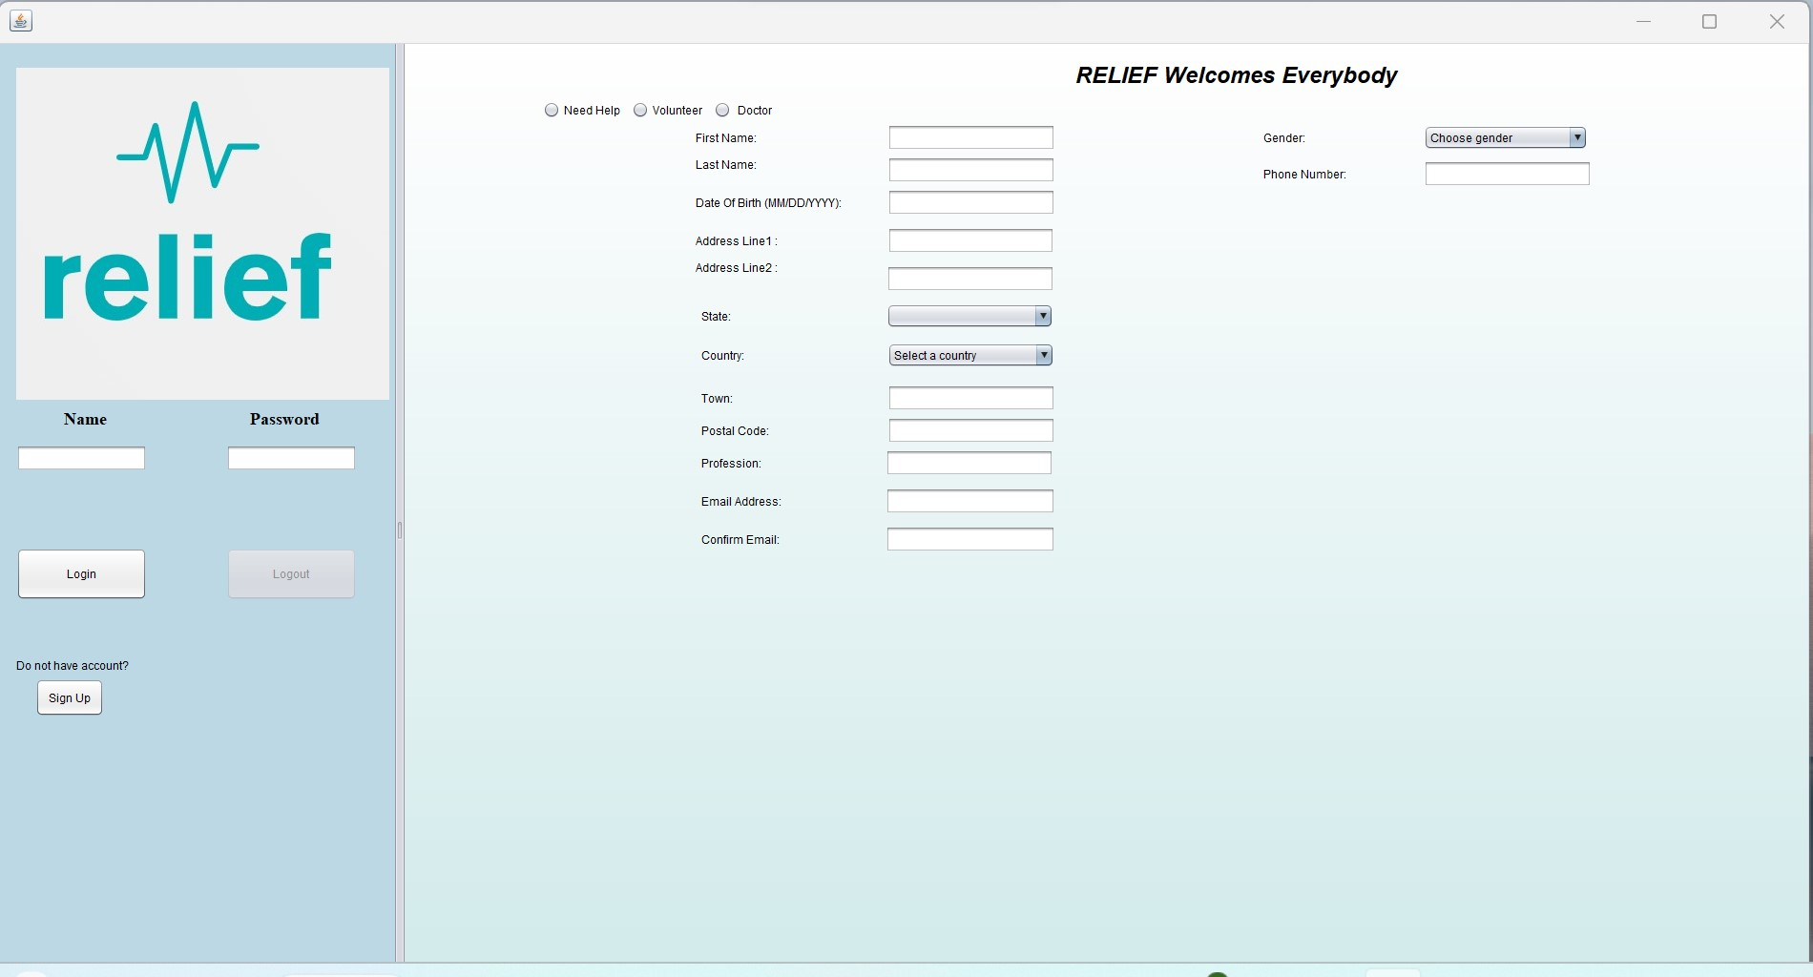
OUTPUT:

Slide 9
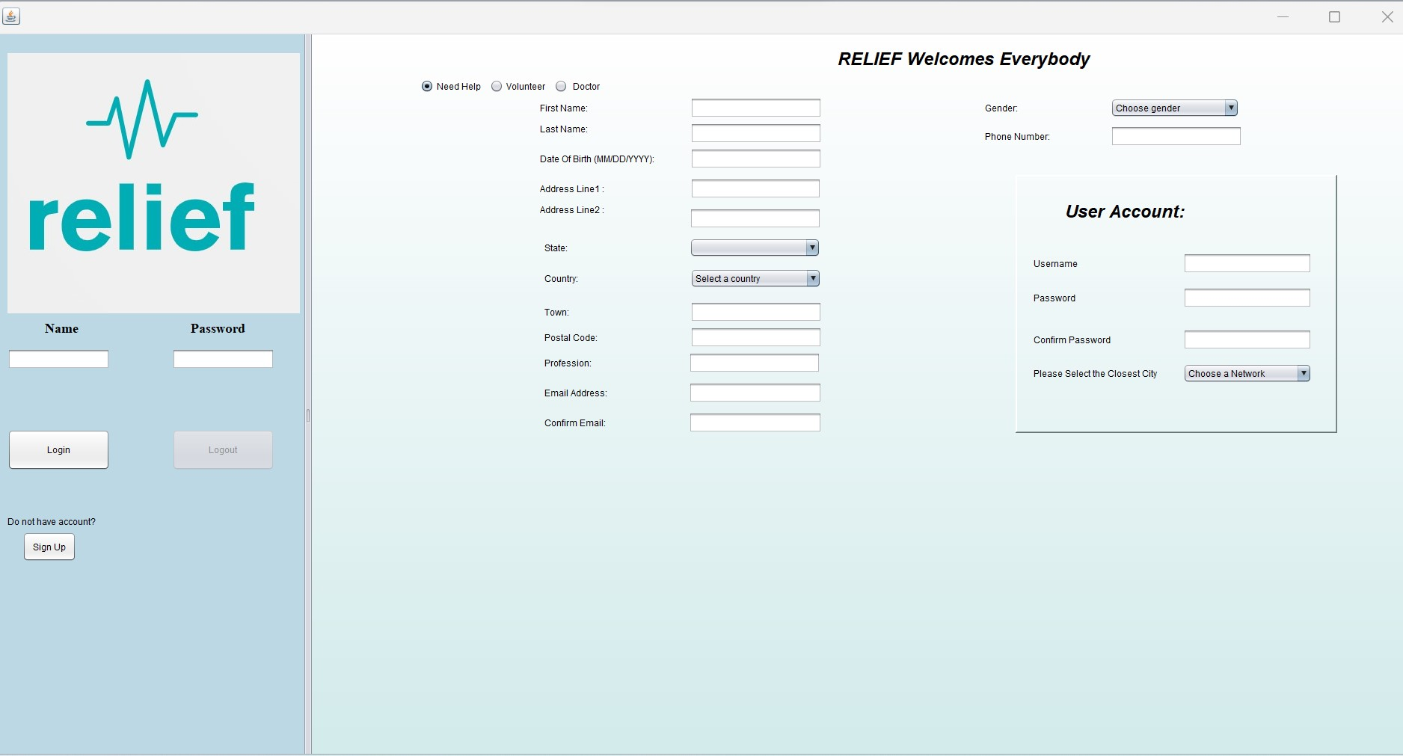

Slide 10
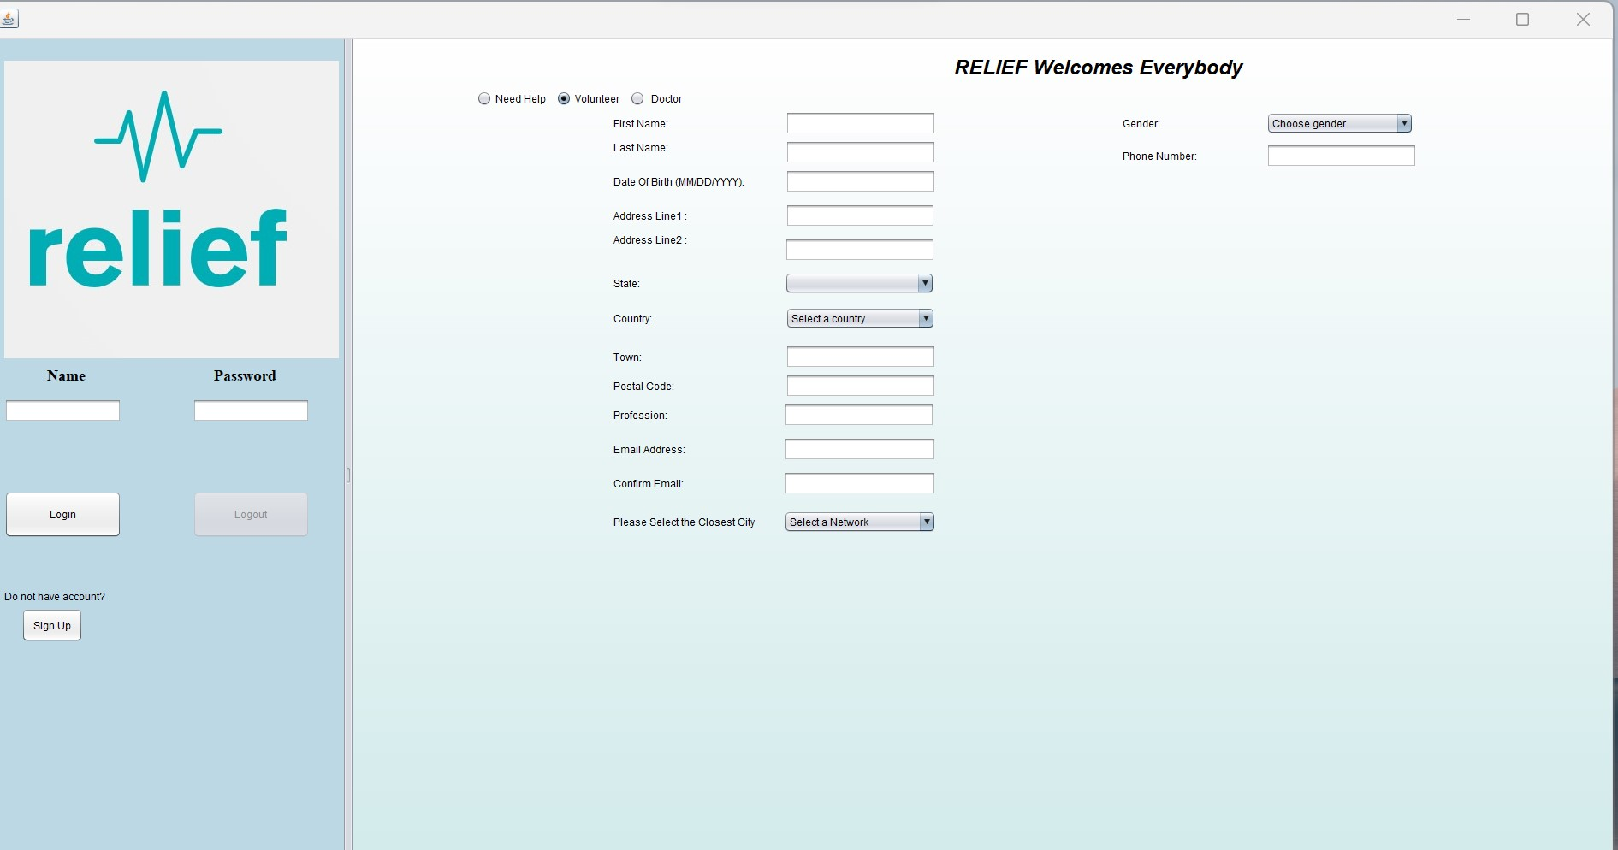

Slide 11
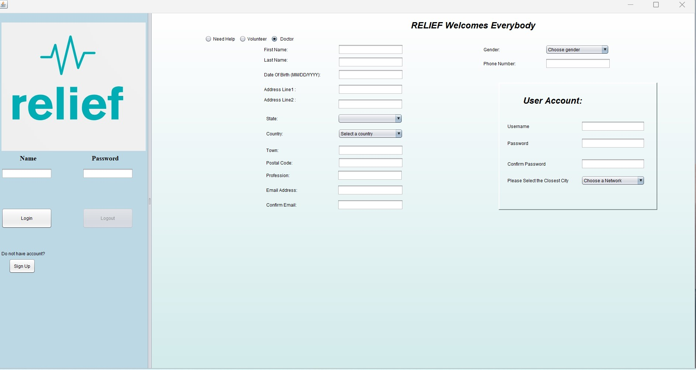

Slide 12
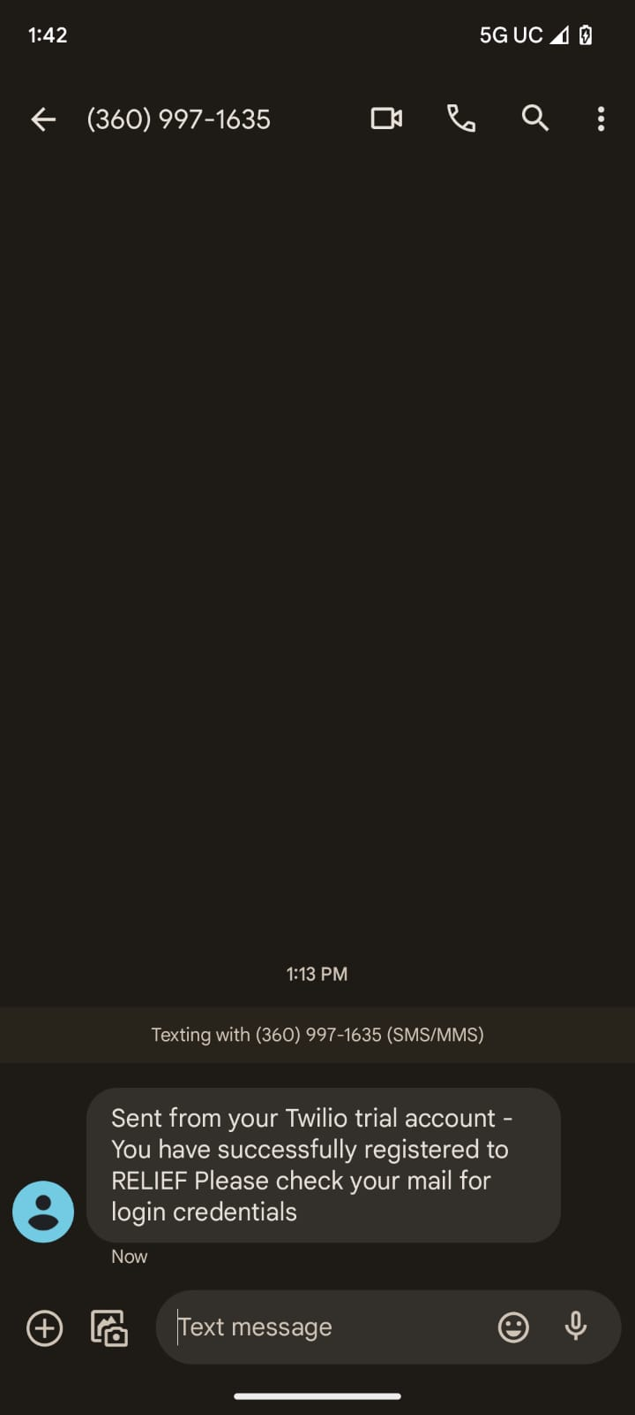

Slide 13
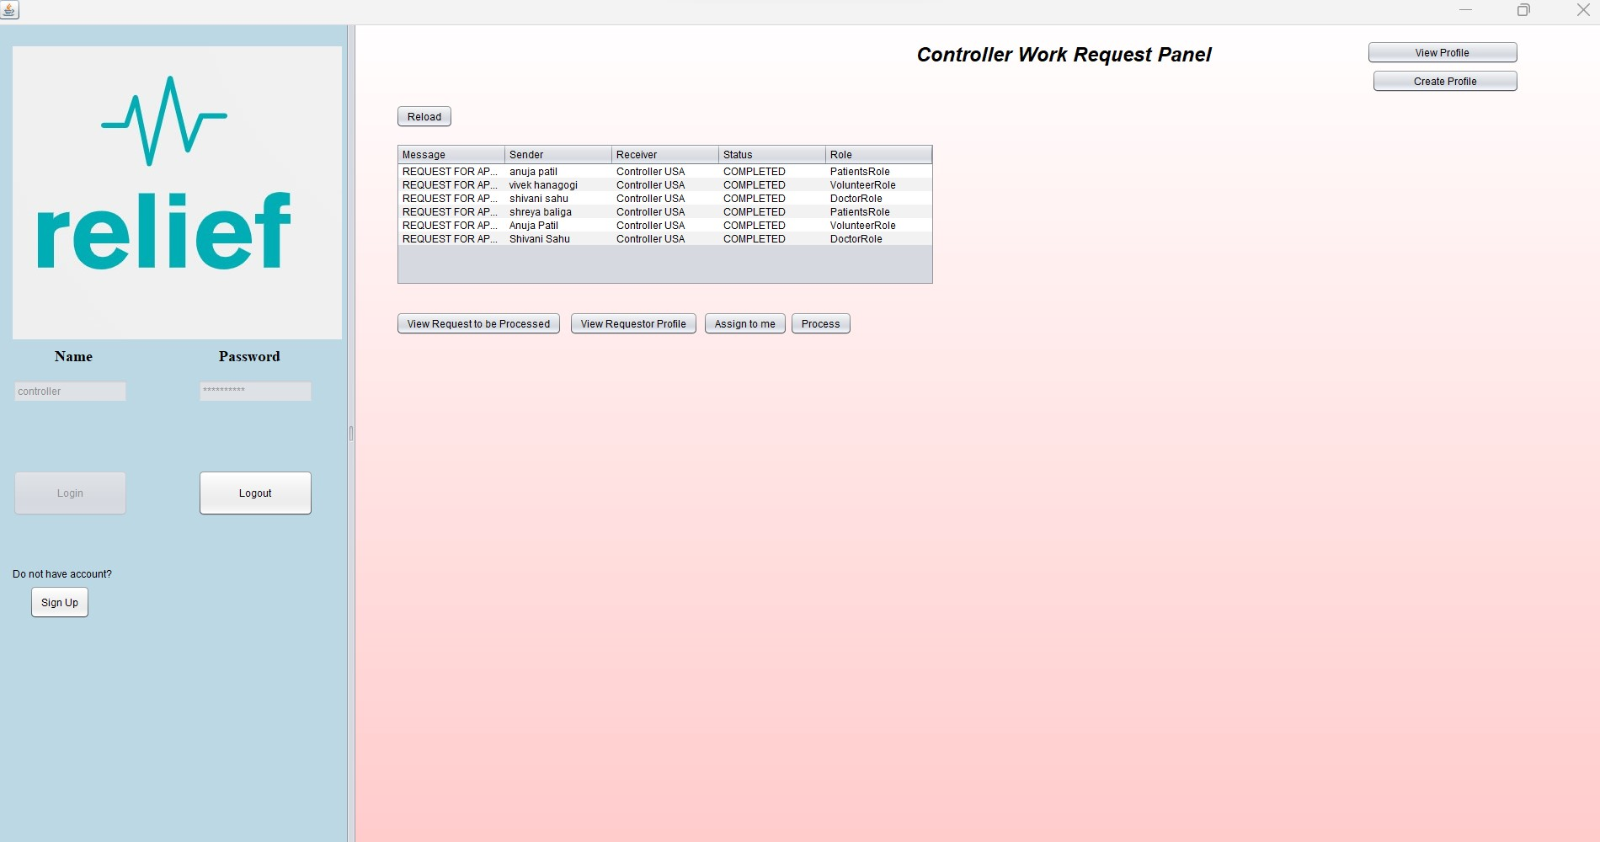

Slide 14
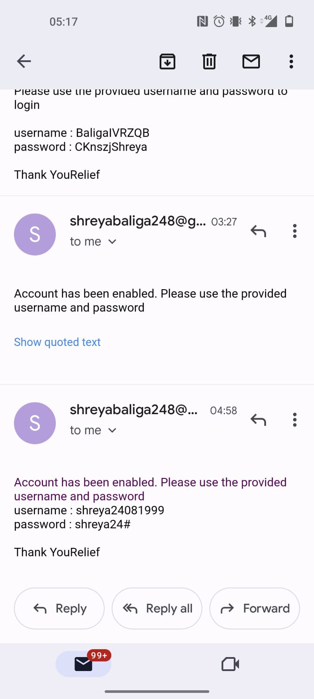

Slide 15
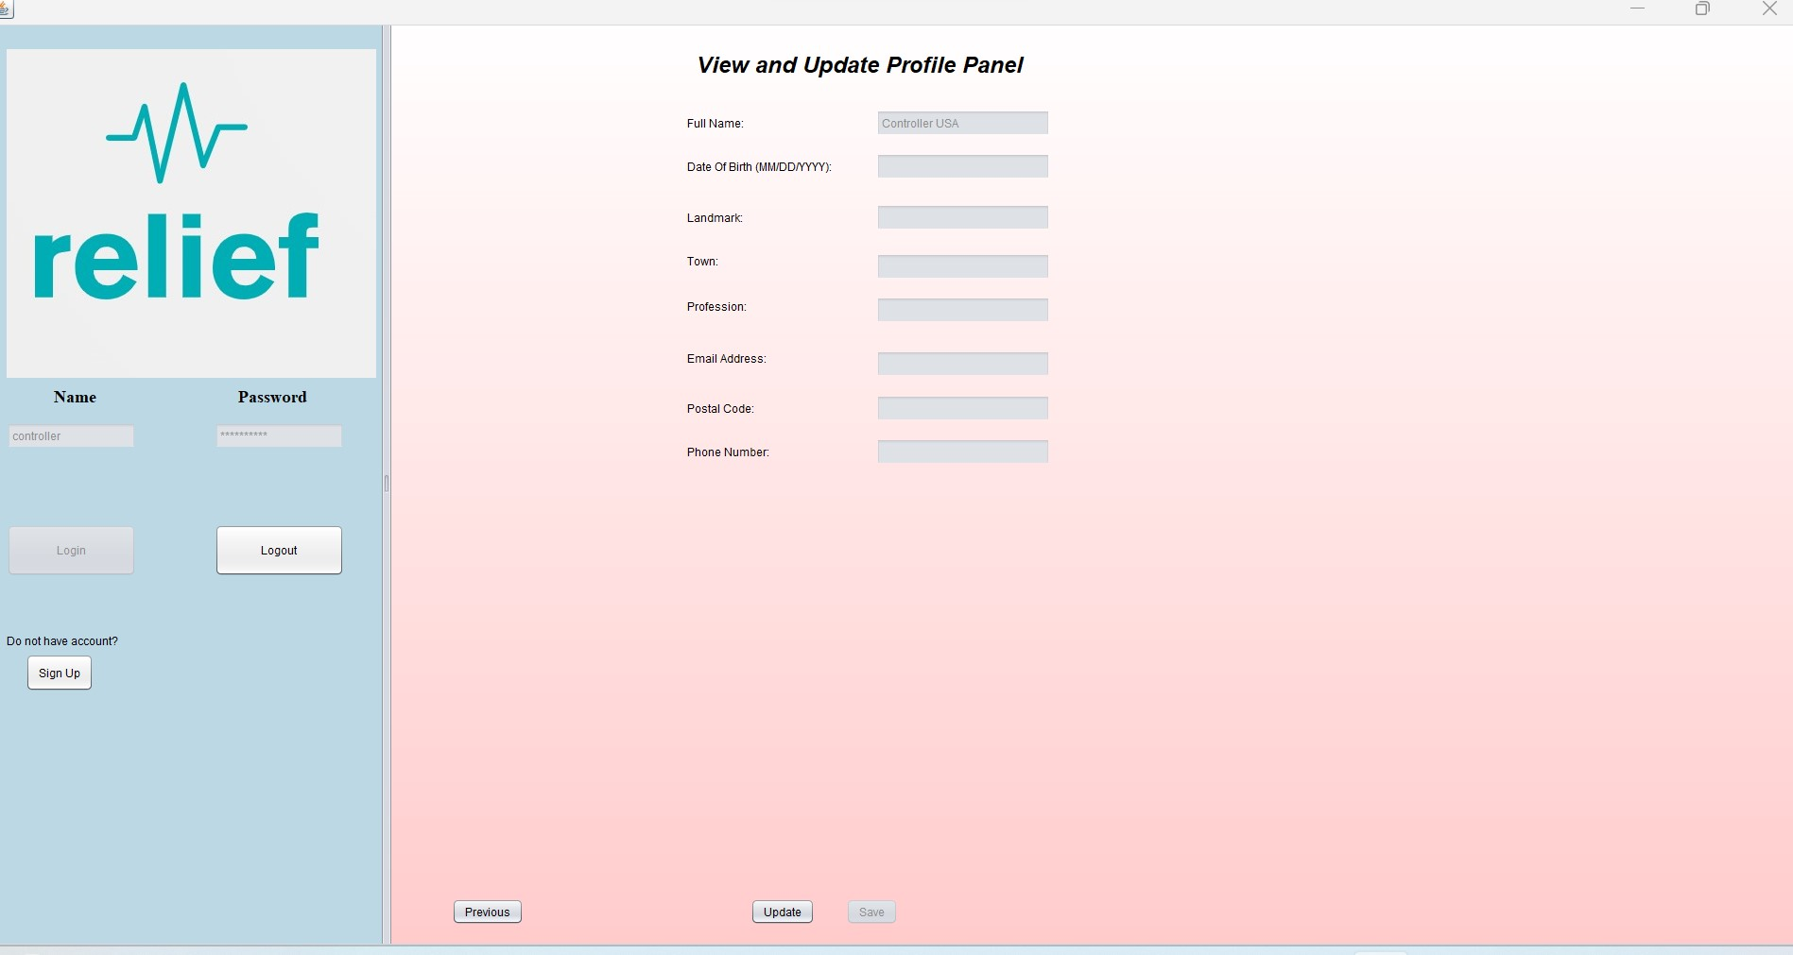

Slide 16
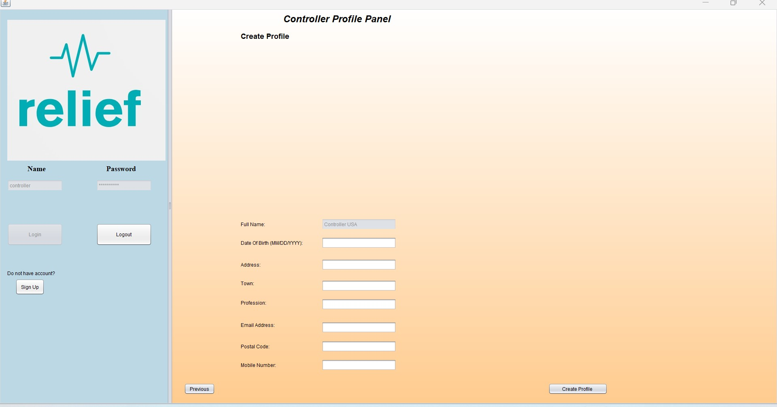

Slide 17
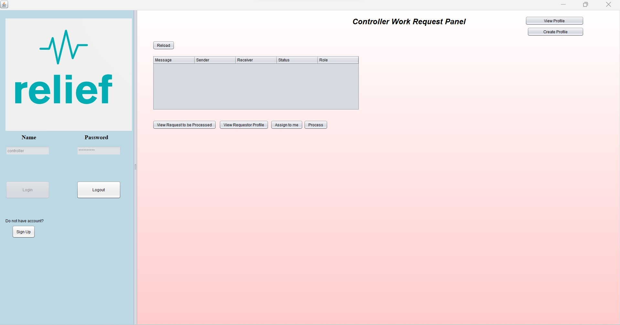

Slide 18
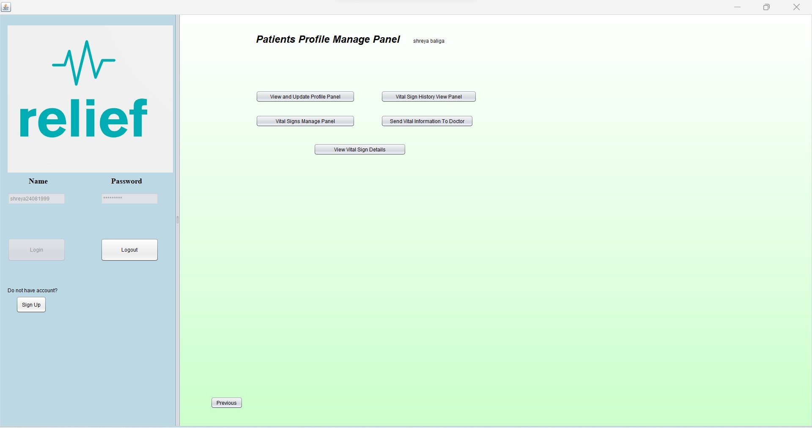

Slide 19
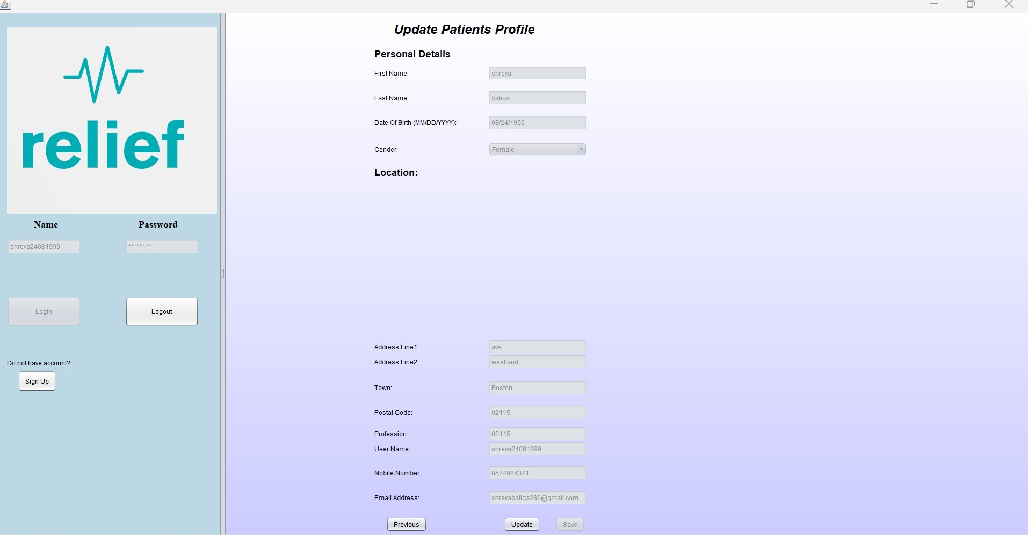

Slide 20
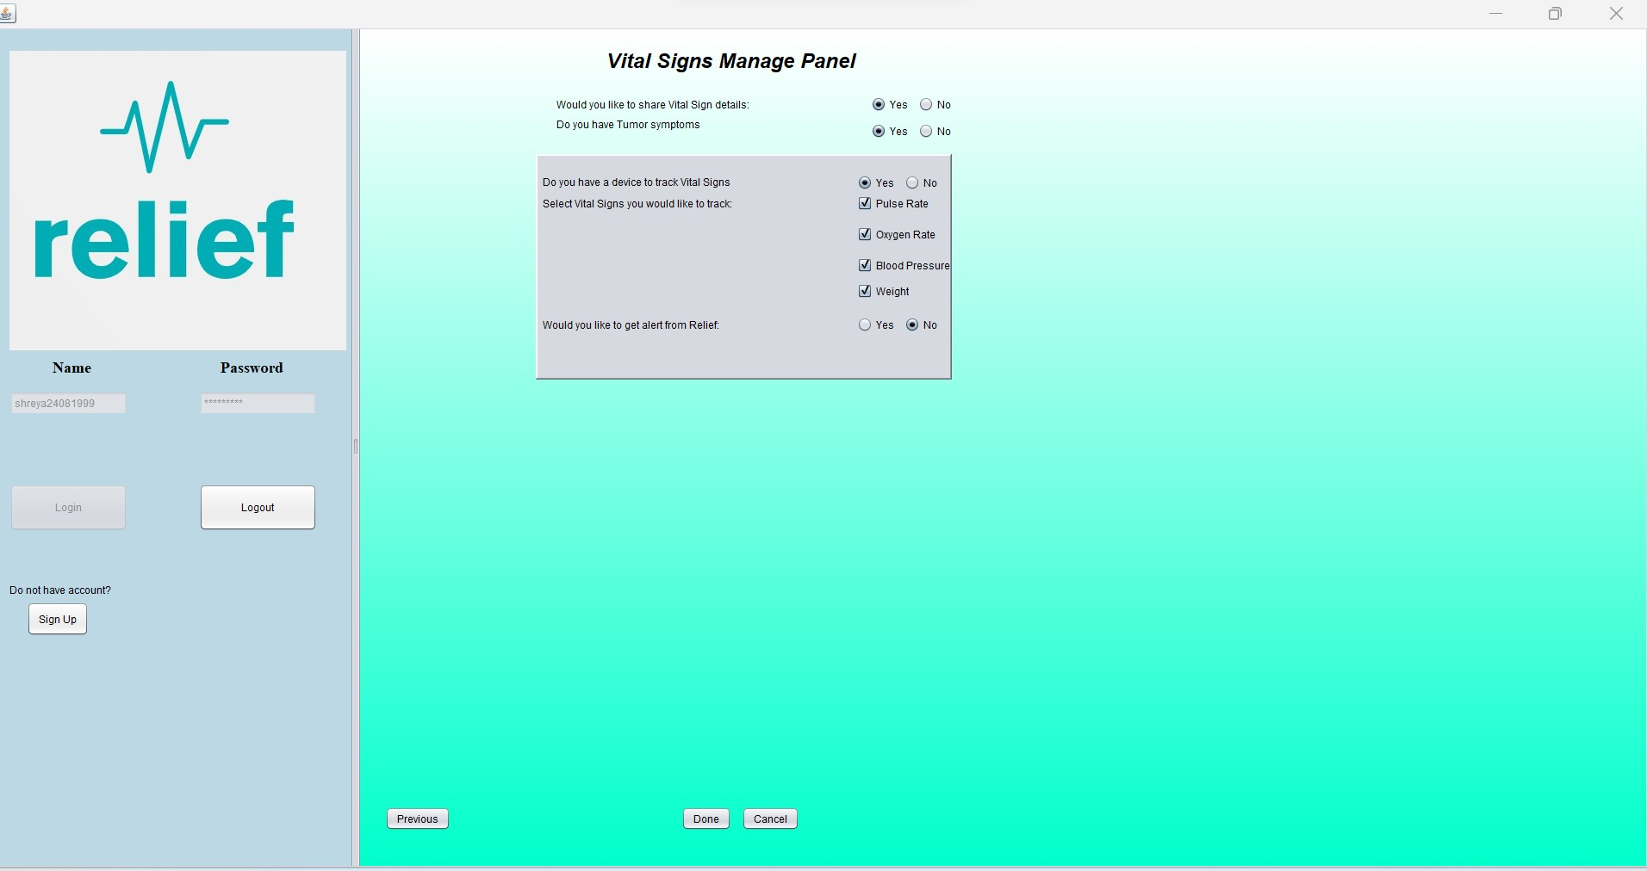

Slide 21
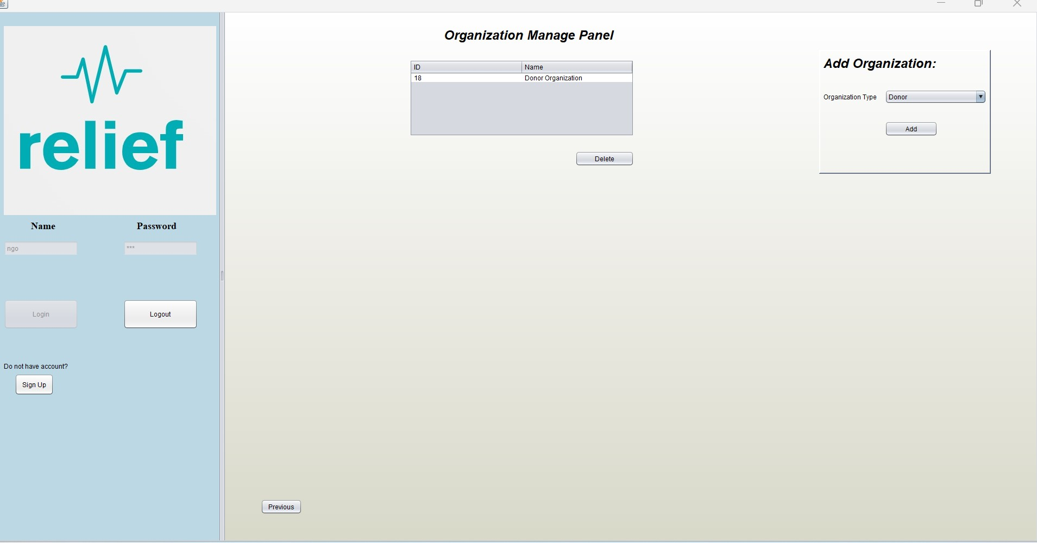

Slide 22
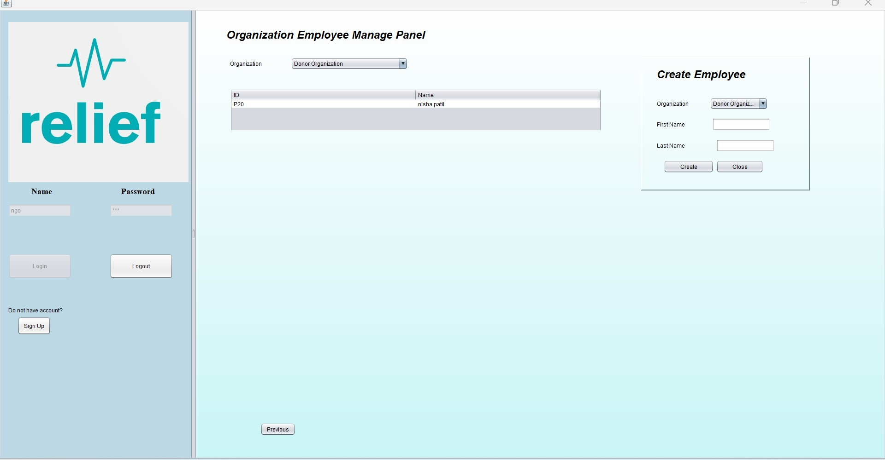

Slide 23
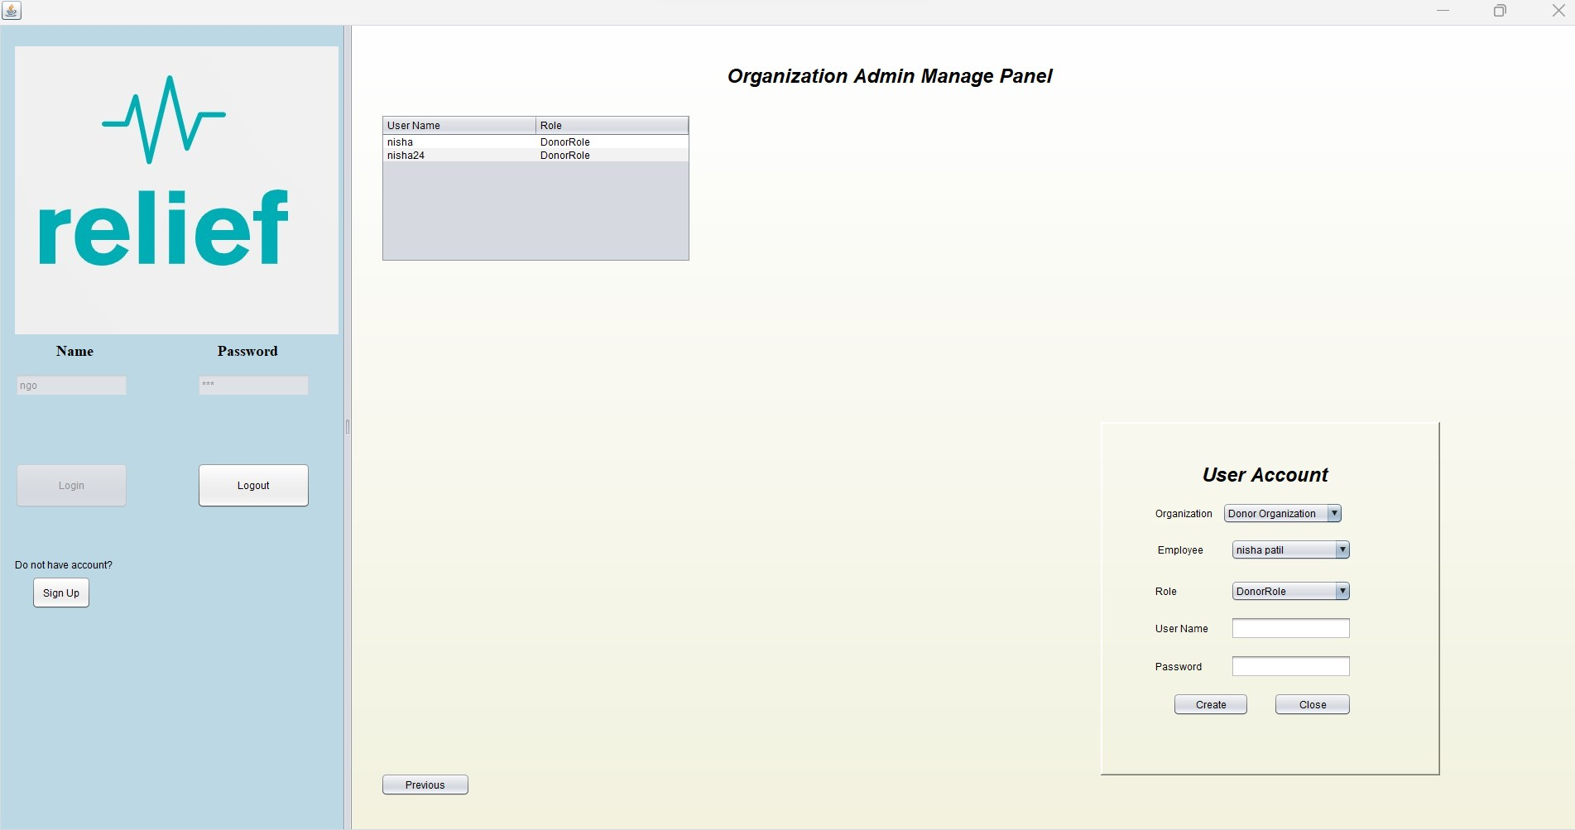

Slide 24
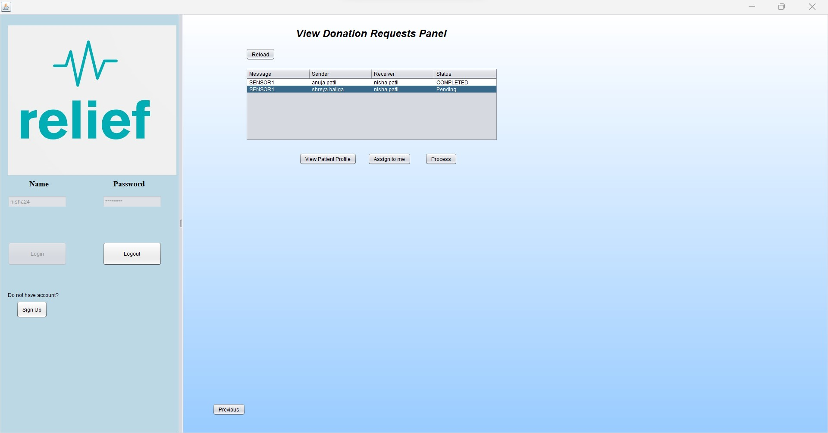

Slide 25
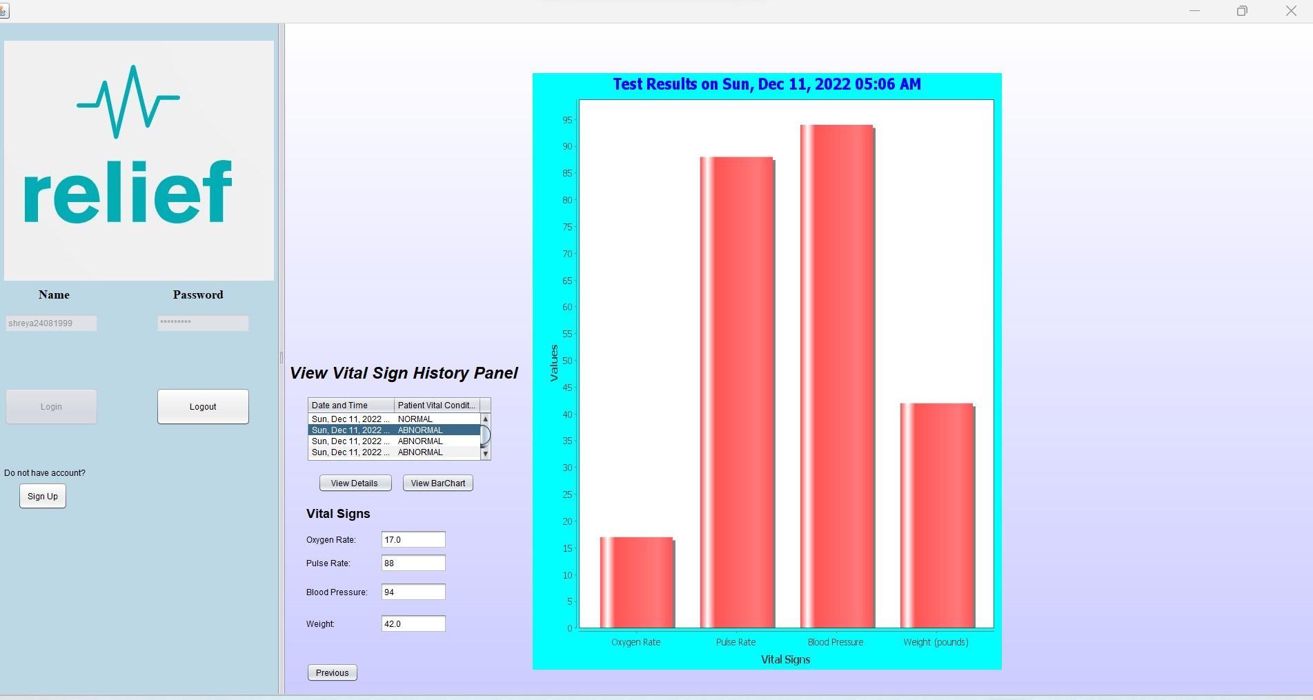

Slide 26
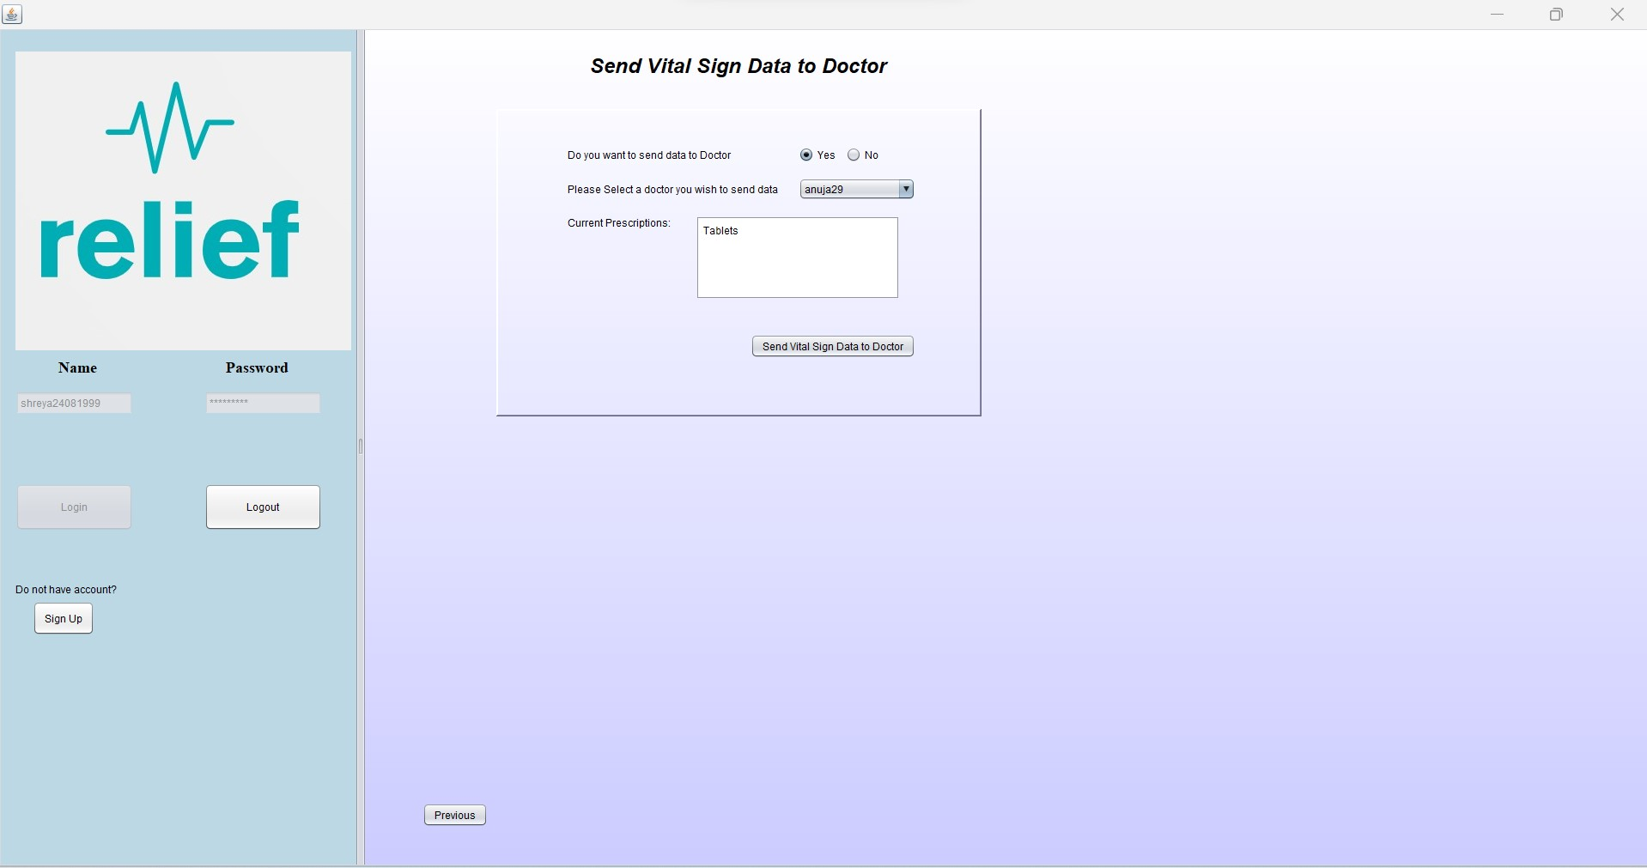

Slide 27
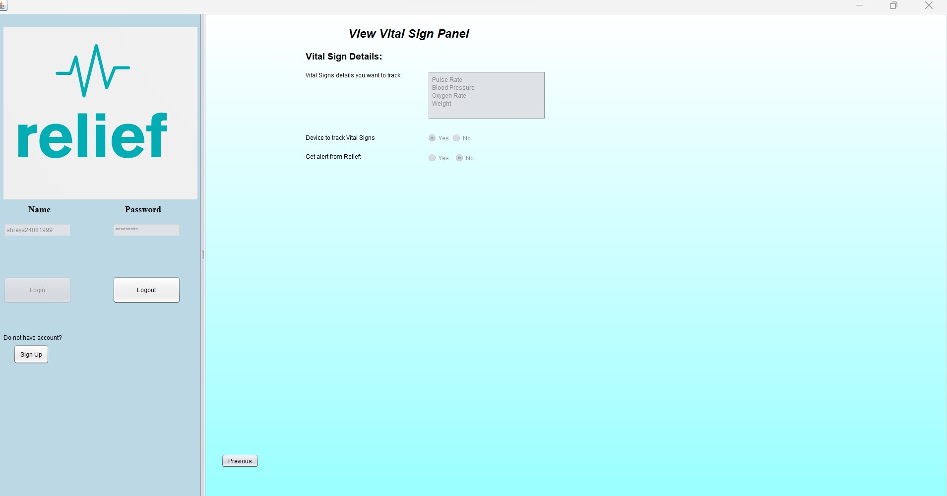

Slide 28
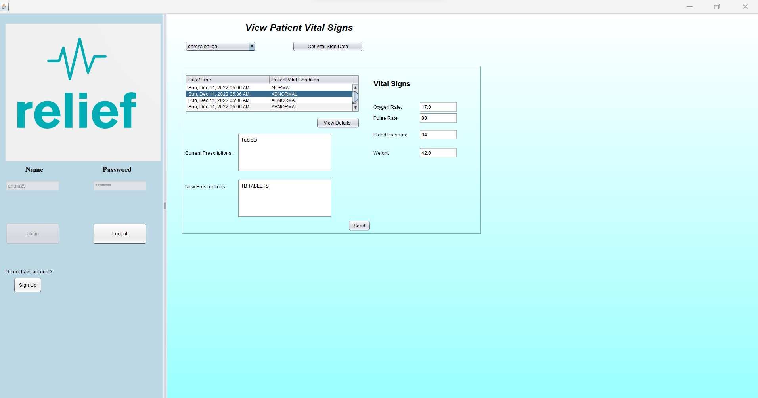

Slide 29
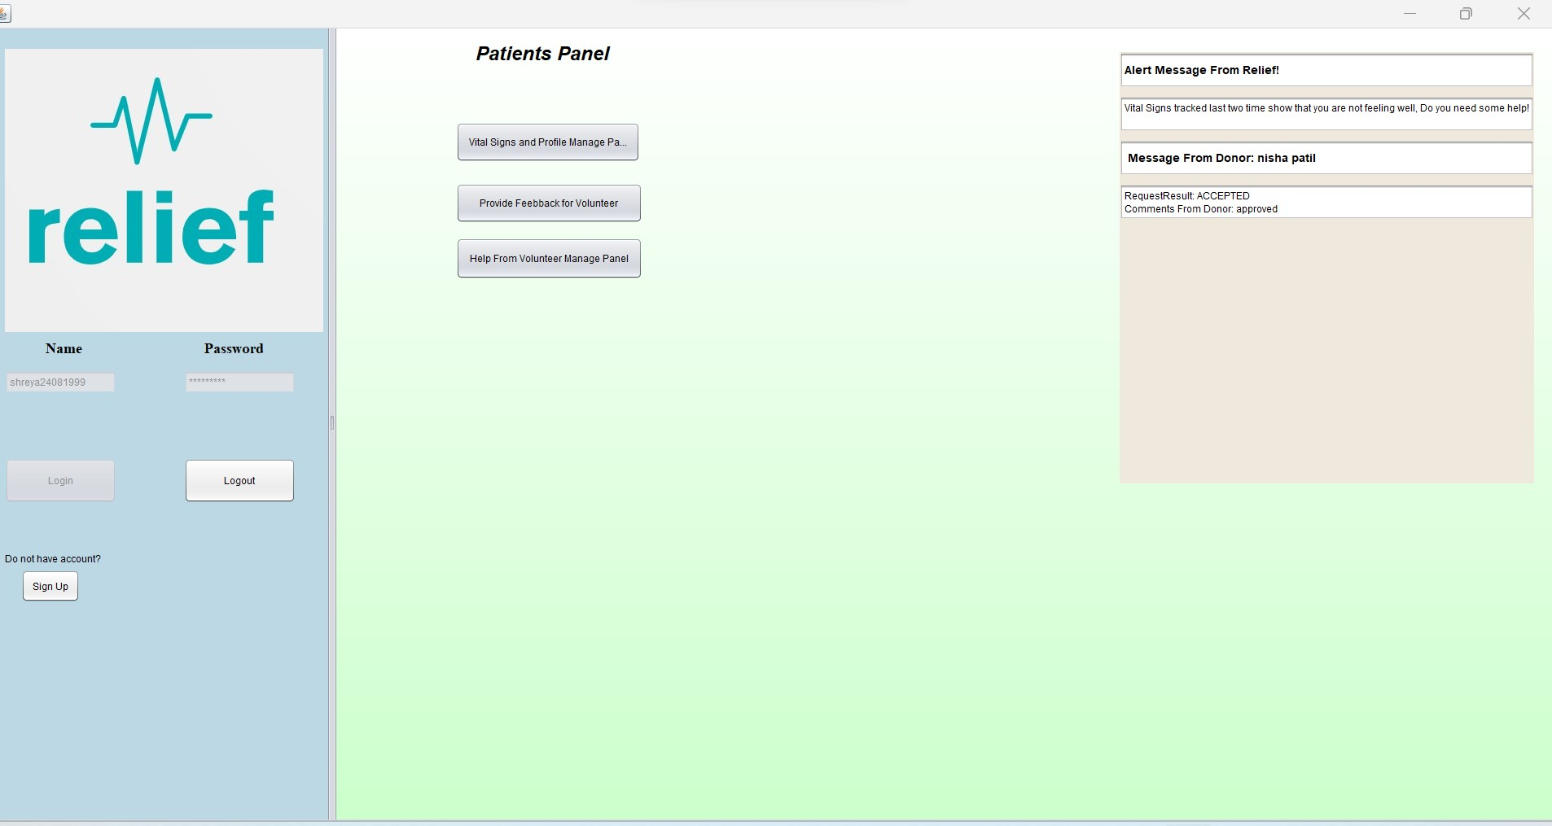

Slide 30
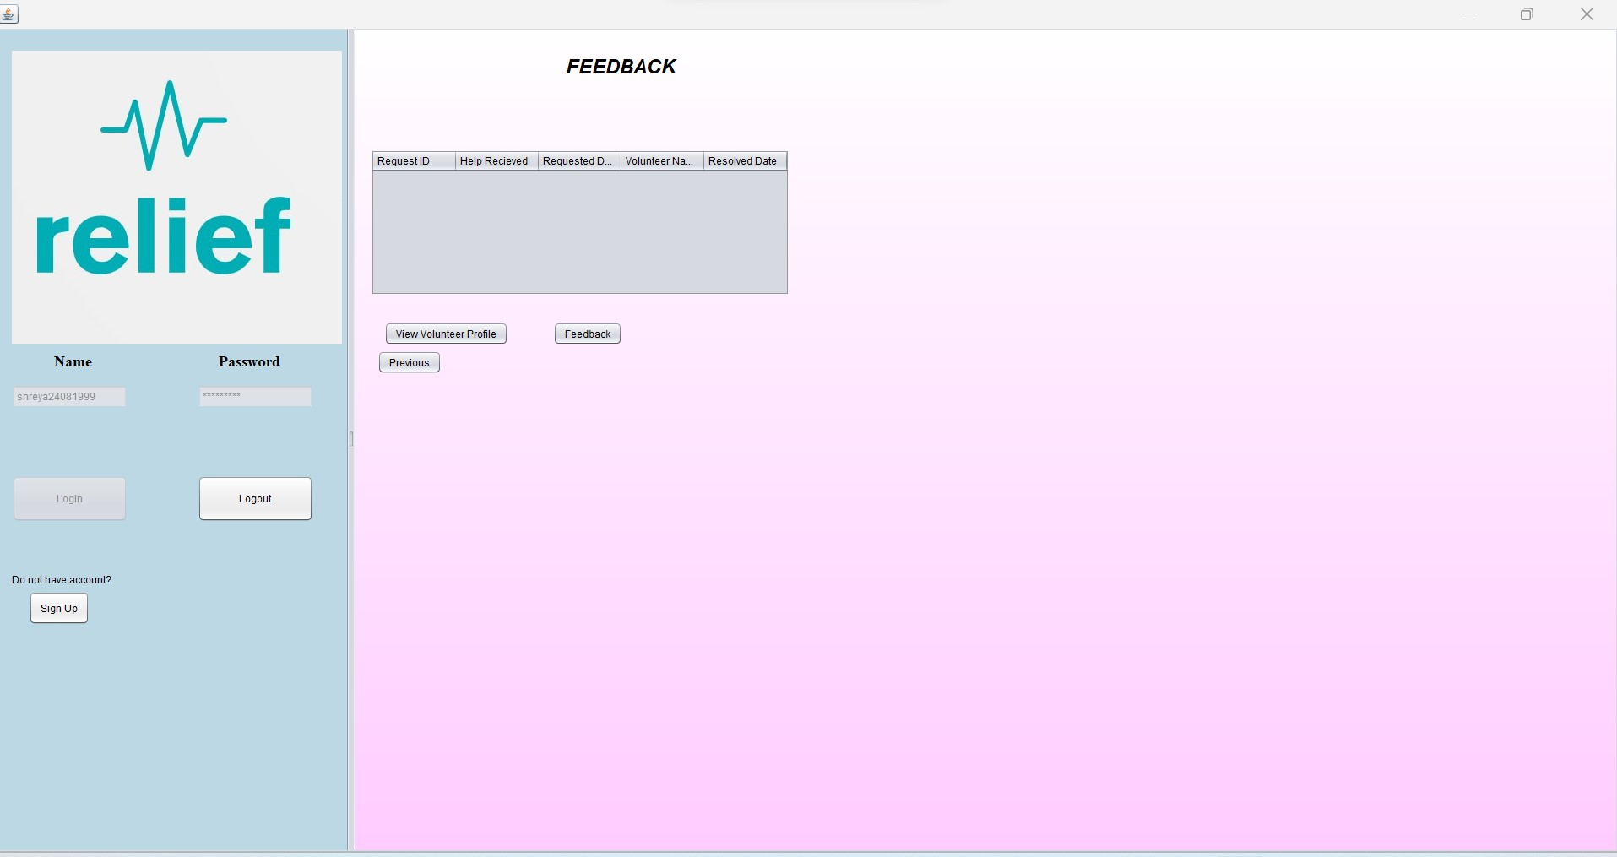

Slide 31
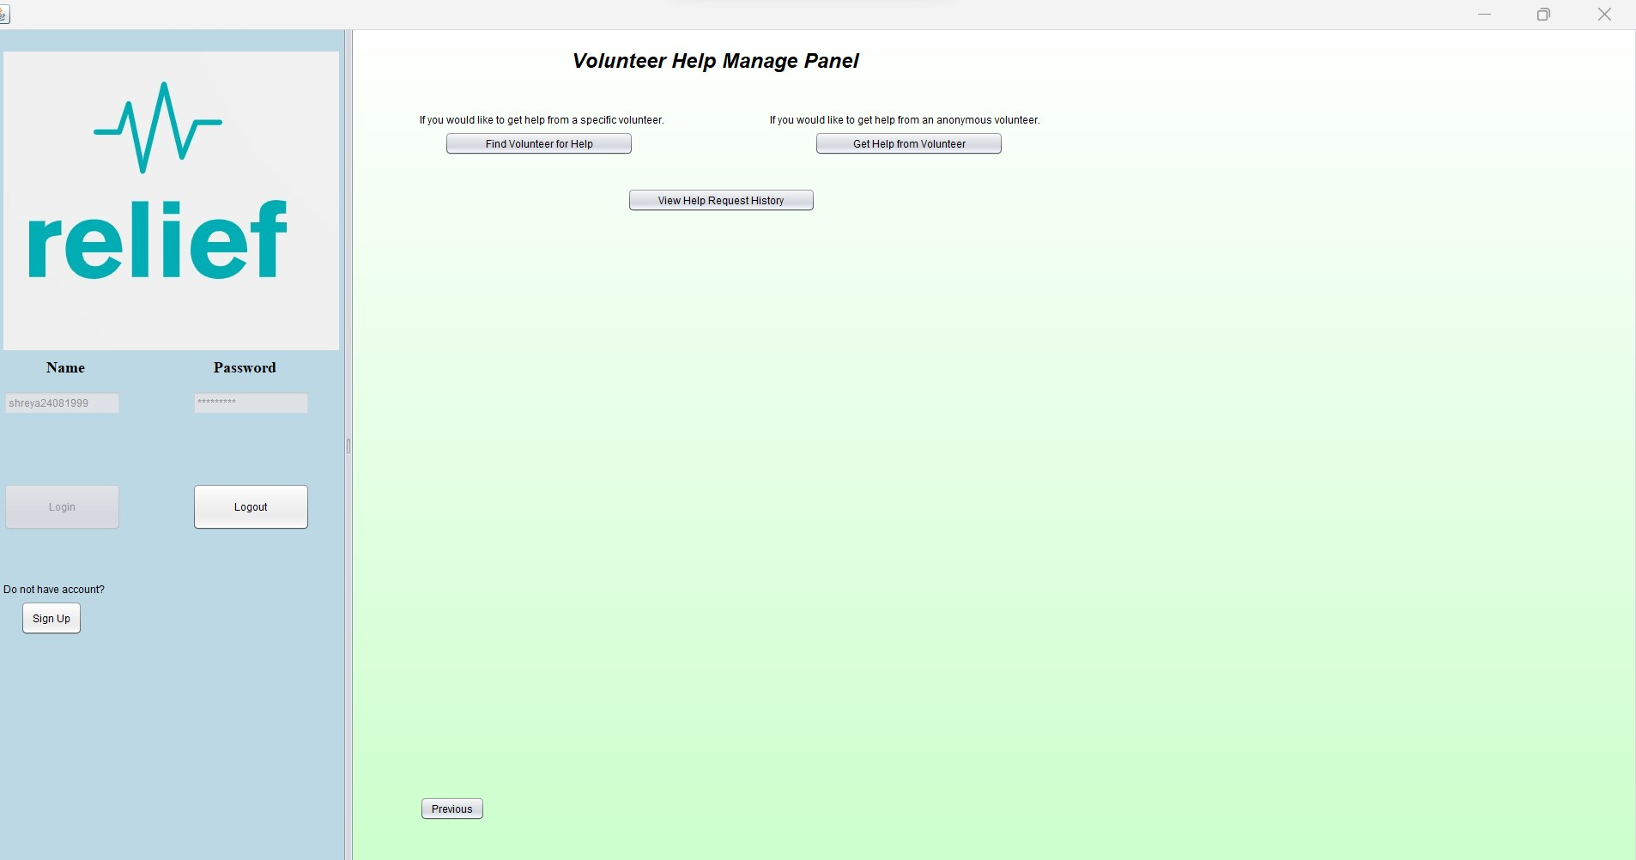

Slide 32
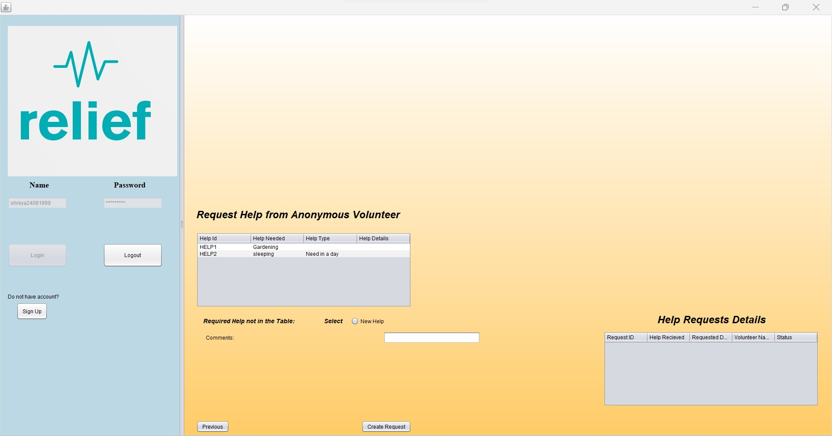

Slide 33
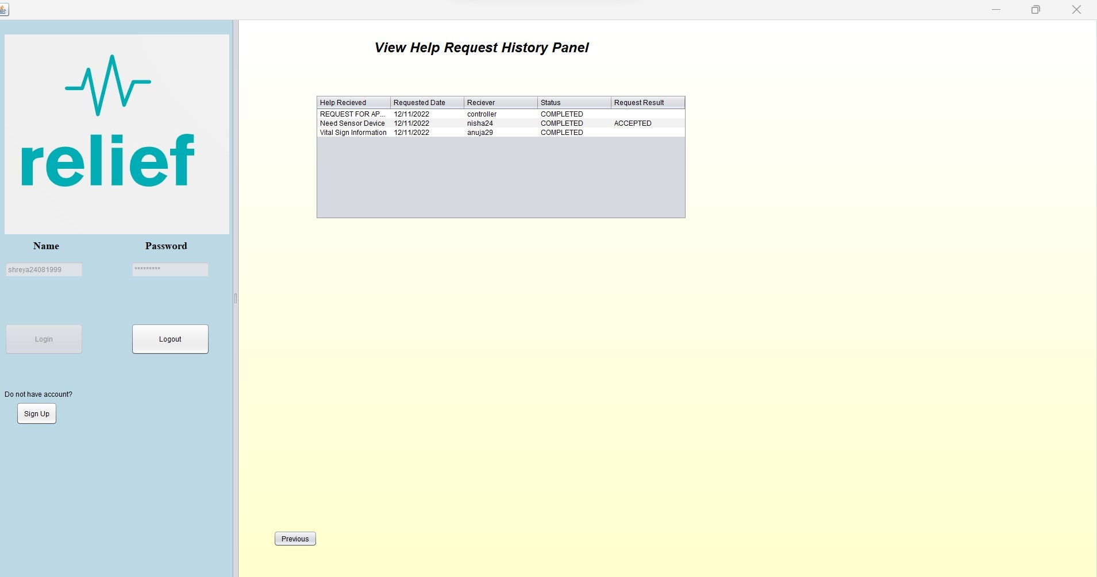

Slide 34
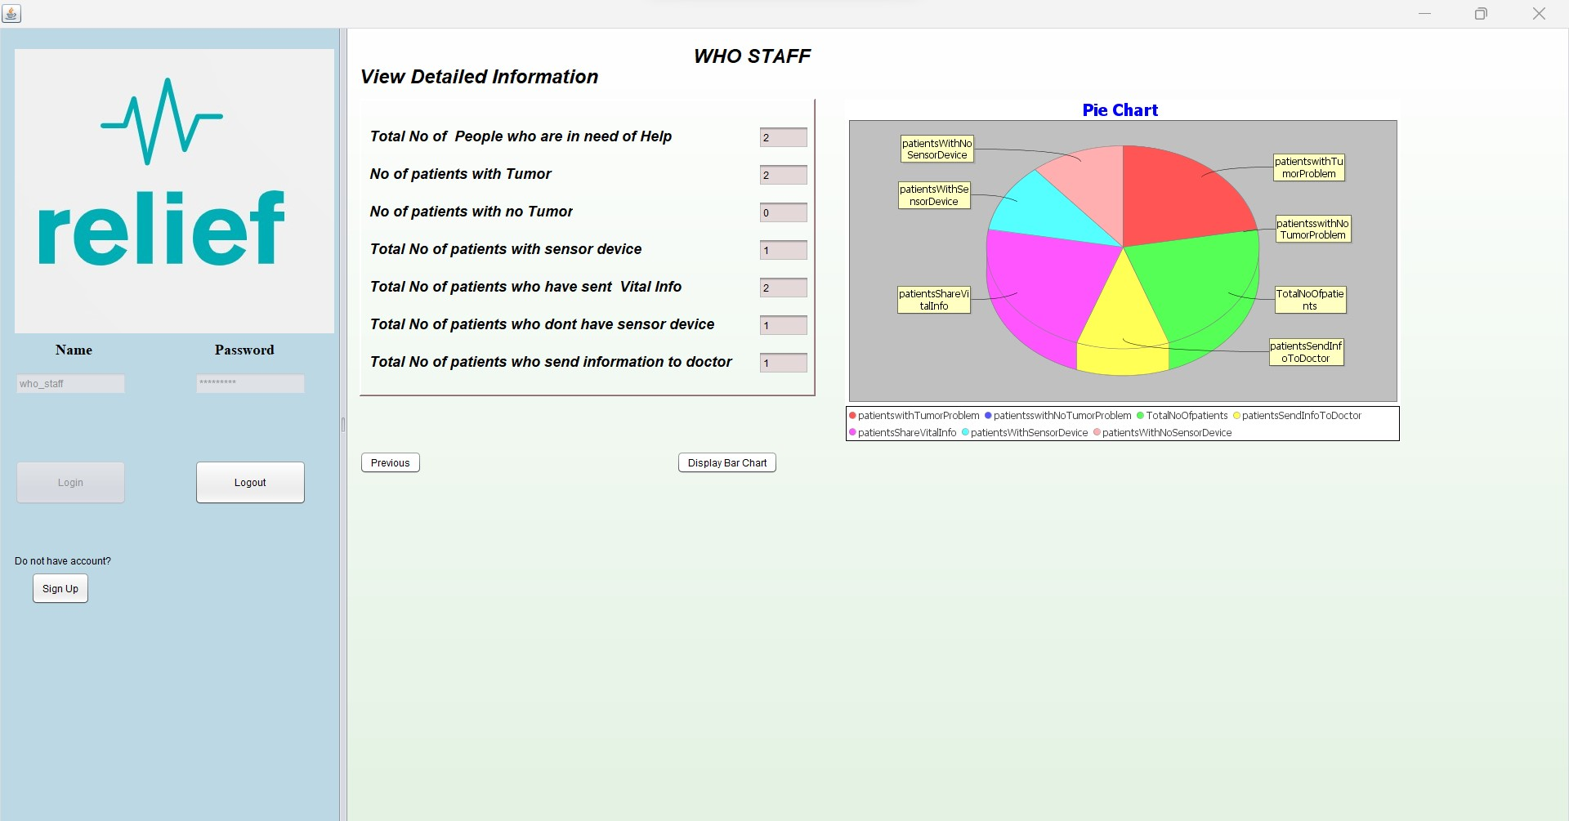

Slide 35
